Slide 1
Capitol Hill Day Webinar
Prepared by:
Leslee Gilbert, Van Scoyoc Associates (VSA)
Joe Danek, The Implementation Group (TIG)
February 15, 2017

Slide 2
Agenda
Budget Request
Congressional Appropriations
Hill Visits – Talking Points
Materials
Question & Answer

Slide 3
FY 2018 Appropriations
The Year Ahead
FY 2017 Continuing Resolution
President’s Budget Request
FY 2018; TBD
FY 2017: $24 million
NSGA Budget Request:
FY2018
$45 million
FY2017
$40 million (flat funding for the program and a cap of 5% for administrative fees for NASA).

Slide 4
Appropriations Committee Members
Senate: Appropriations
Chair, Thad Cochran (MS)
Ranking Member, Patrick J. Leahy (VT)
House: Appropriations
Chair, Rodney Frelinghuysen (R-NJ-11)
Ranking Member, Nita Lowey (D-NY-17)
Senate Subcommittee Commerce, Justice, Science, and Related Agencies
Chair, Richard Shelby (AL)
Ranking Member, Jeanne Shaheen (NH)
House Subcommittee Commerce, Justice, Science, and Related Agencies
Chair, John Culberson (R-TX-7)
Ranking Member, José E. Serrano (D-NY-15)
Majority:
Lamar Alexander (TN)
Susan Collins (ME)
Lisa Murkowski (AK)
Lindsey Graham (SC)
John Boozman (AR)
Shelley Moore Capito (WV)
James Lankford (OK)
John Kennedy (LA) *
Minority:
Patrick Leahy (VT)
Dianne Feinstein) CA)
Jack Reed (RI)
Chris Coons (DE)
Brian Schatz (HI) *
Joe Manchin (IL) *
Chris Van Hollen (MD)*
Majority:
Harold Rogers (KY-5)
Robert Aderholt (AL-4)
John Carter (TX-31)
Martha Roby (AL-2)
Steven Palazzo (MS-4)
Evan H. Jenkins (WV- 3)*
Minority:
Derek Kilmer (WA-6)
Matt Cartwright (PA-17) *
Grace Meng (NY-6)*
* New to committee

Slide 5
Congressional Meetings
Structure of Meeting.
Introductions and thank them for taking meeting
Do your homework - be knowledgeable about your legislators background and their work on similar interests to forge connections
Explain what Space Grant is and how it works in their state
Provide specific examples of your success, ask for their support
National Space Grant one pager
State Space Grant materials
Invite your legislator and his/her staff to visit your university
Follow Up
Email/Write the Legislator/Legislative Aide to thank them for their help and support
Keep in contact throughout the year, send newsletters/announcements

Slide 6
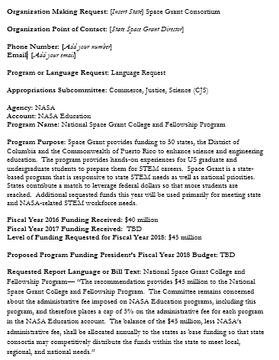
Appropriations Member Request Form

Slide 7
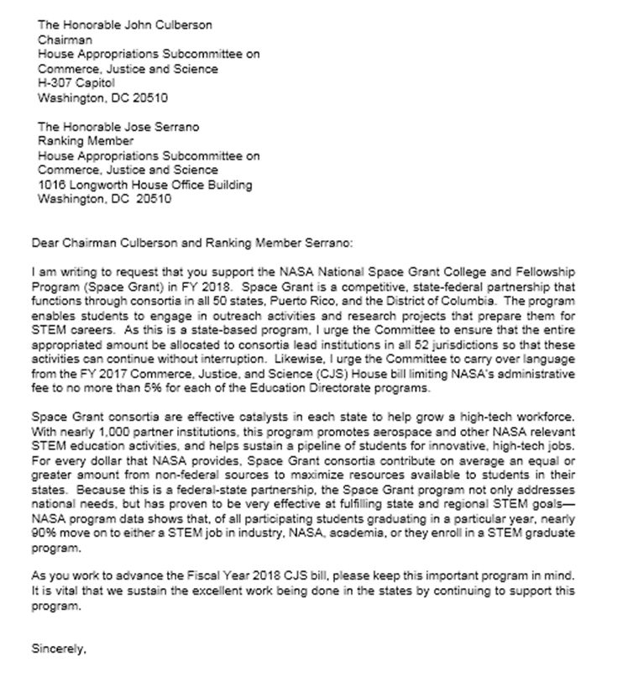
Appropriations Letter of Support

Slide 8
Materials
House and Senate Directories
Online resources:
http://www.c-span.org/congress/members/
https://www.govtrack.us/congress/members
Capitol Hill Maps
House and Senate Member request letters
Language requests for member appropriation form
“How to Communicate with Congress”
Congressional Visit Report

Slide 9
Leave Behind Materials

Slide 10
Leslee Gilbert
202 -737-8163
lgilbert@vsadc.com

