Slide 1
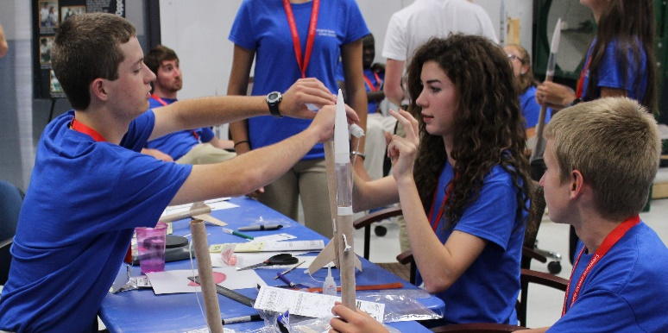
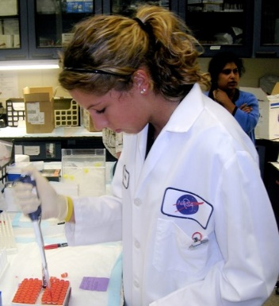
Inspiring the next generation STEM workforce 2020
REQUEST FOR FY 2021 APPROPRIATIONS
The recommendation provides $125 million for NASA’s Office of STEM Engagement, and no less than $52 million to the National Space Grant College and Fellowship Program. The Committee directs amounts be allocated to State consortia for competitively awarded base grants to support local, regional, and national STEM needs, and directs all 52 participating jurisdictions receive no less than $844,000 each. The Committee allocates no more than 10% to an administrative fee for each program in the Office of STEM Engagement, and the remaining $2.6 million shall fund special programs operated by Space Grant institutions to further the science and education mission of NASA and the states.
SPACE GRANT HIGHLIGHTS
Established in 1989. Competitive, highly effective national partnership program responsive to NASA-aligned state, regional, and national priorities.
Administered by State consortia. Catalysts to grow a future workforce to meet the needs for existing and new STEM-related jobs.
Includes STEM programs with experiential learning. Internships, fellowships, apprenticeships, and industry partnerships. Hands-on experiences include: launch vehicle and payload development, engineering, and assembly; space flight operations; UAVs; remote sensing; aircraft maintenance; cybersecurity; and space flight design.
Leverages partnerships across State consortia and with NASA. Builds national networks committed to developing and sustaining a diverse, high-technology workforce in academia, industry/business, and government.
Funding Justification
Strengthen and promote our national network of state-based systems in partnership with NASA, committed to developing and sustaining a diverse well-prepared STEM workforce.
Improve student accessibility to an expanded range of STEM-based experiential learning opportunities, STEM researchers and mentors.
Broaden, extend, and accelerate participation of underrepresented minorities and women in STEM-based academic fields and careers.
Advance the nation’s STEM education and workforce pipe-line to further the progress of science and create knowledge that transforms the future and sustains our global leadership.
The NATIONAL SPACE GRANT ALLIANCE exists to enhance the capacity of the United States of America to carry out education, research, and public outreach activities in science, technology, engineering, and mathematics (STEM) disciplines, particularly in fields related to space, aeronautics, and earth system science.

Slide 2
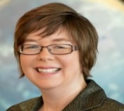
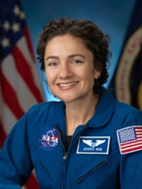
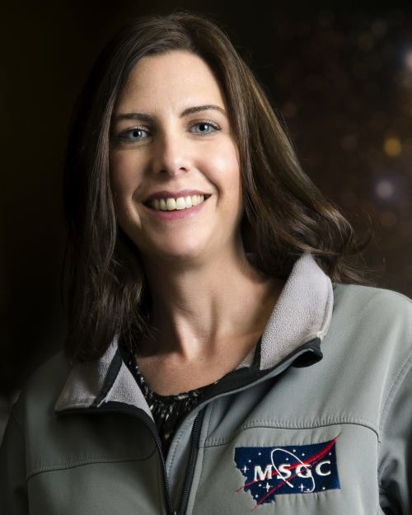
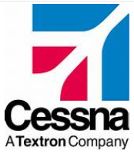
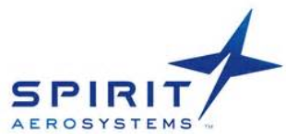
Inspiring the next generation STEM workforce 2020
Space wORKFORCE CRISIS
18th, 37th
U.S. lags in STEM literacy among 15 y/o students ranking in science and math among 71 countries.
30th
U.S. ranking of 32 OECD countries in Engineering as percentage of degrees awarded.
374,000
U.S. space scientist, engineer, technician, and STEM higher educator job openings predicted by 2028, including 31,000 scientists and 187,000 engineers.
>$20B
Invested in commercial ventures by 430 space firms, and accelerating in recent years.
>3,000
Open jobs across 140 companies in space industry, featured on Space Talent website.
Space grant students
Space Grant Participants
>5,100
COLLEGE STUDENTS received Space Grant funding
>1,000
AFFILIATES and COLLABORATORS
88%
Space Grant COLLEGE STUDENTS remain in STEM fields
52
CONSORTIA in all 50 states, DC, and PR
OUTREACH
FY18
FY18
Diversity
>42,000
EDUCATORS ENGAGED
24%
UNDERREPRESENTED PARTICIPANTS
>434,000
PRECOLLEGE STUDENTS REACHED
43%
FEMALE PARTICIPANTS
FY18
FY18
A Few Notable Space Grant Alumni
Jessica Watkins
Astronaut in Training, NASA
Ph.D., Geology
Career Fields: Aeronautics, Geomorphology
Michael Smayda
Founder, Hermeus Aviation & Aerospace
Ph.D., Aerospace Engineering
Career Field: Hypersonic aircraft aerodynamics
Michelle Larson
President & CEO, Adler Planetarium
Ph.D., Physics
Career Field: Citizen science outreach
Jessica Meir
Astronaut, NASA
Ph.D., Marine Biology
Career Fields: Aeronautics, Aquanautics
Nathanael Miller
Chief Technology Officer, Titomic Limited
M.S., Mechanical Engineering
Career Field: Aerospace engineering
Jason Dunn
Co-Founder, Made in Space Inc.
M.S., Aerospace Engineering
Career Field: Commercial space manufacturing
Twyman Clements
Co-Founder & CEO, Space Tango
M.S., Mechanical Engineering
Career Field: Space technology
Angela Des Jardins
Chair, National Space Grant Council
Ph.D., Physics
Career Fields: Higher education, Astrophysics
Examples of STEM student internships and career placements
800 Maine Avenue, SW, Suite 800
Washington, D.C. 20024

