Slide 1
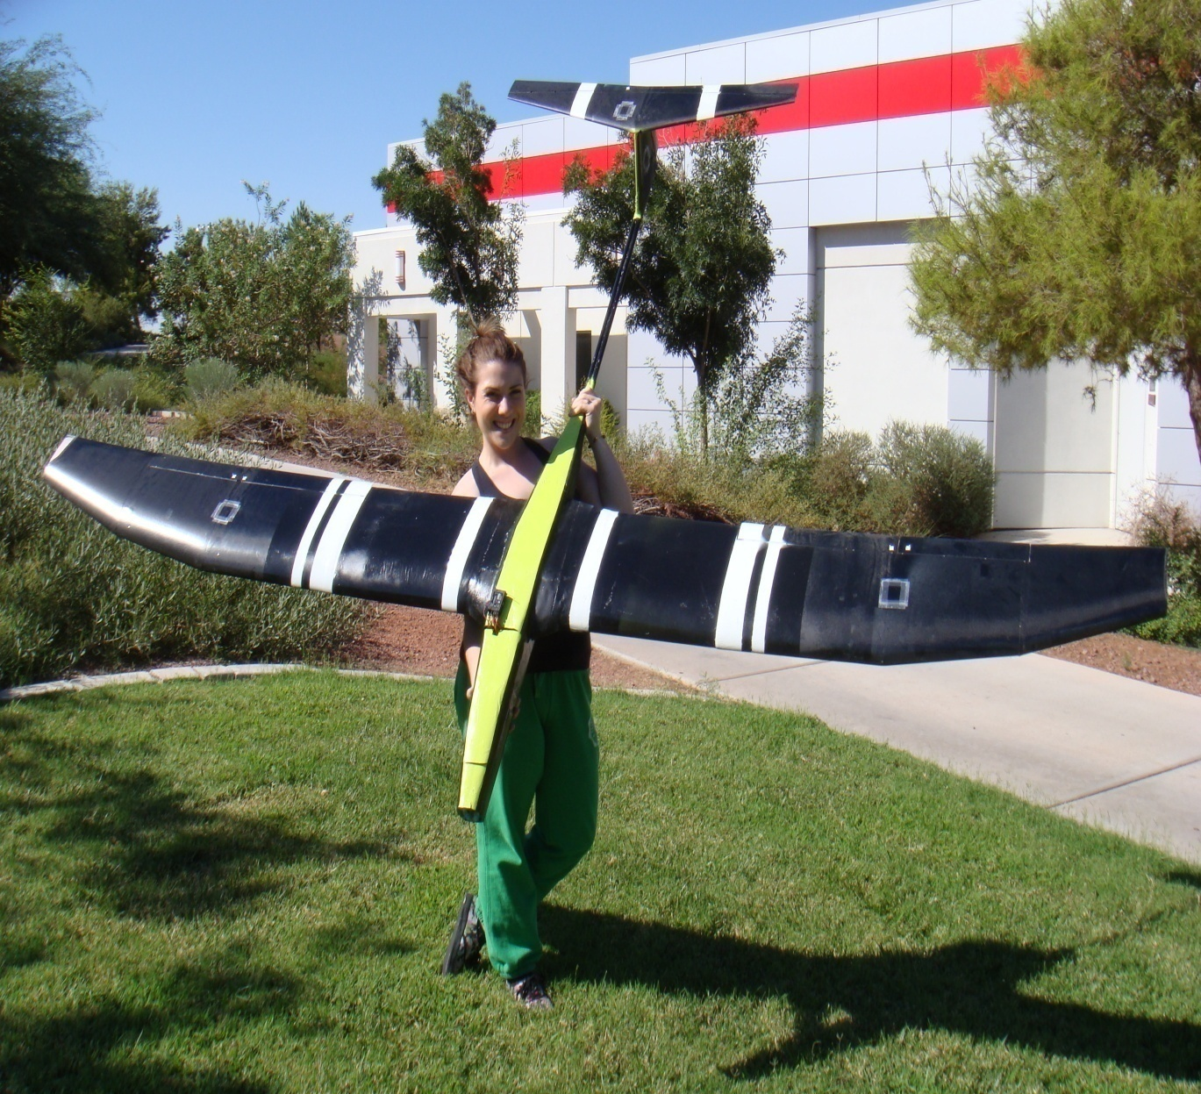
UNLV-Unmanned Aerial Vehicle (UAV) Thin-Film Solar Cell Initiative
Ann Marie Frappier
Wade McElroy
David Glaser
Louis Dube
Dr. Darrell Pepper
September 18, 2009
UNLV

Slide 2
Presentation Overview
Project Review
Final Design
Airframe Optimization
Component Selection
Construction
Questions?

Slide 3
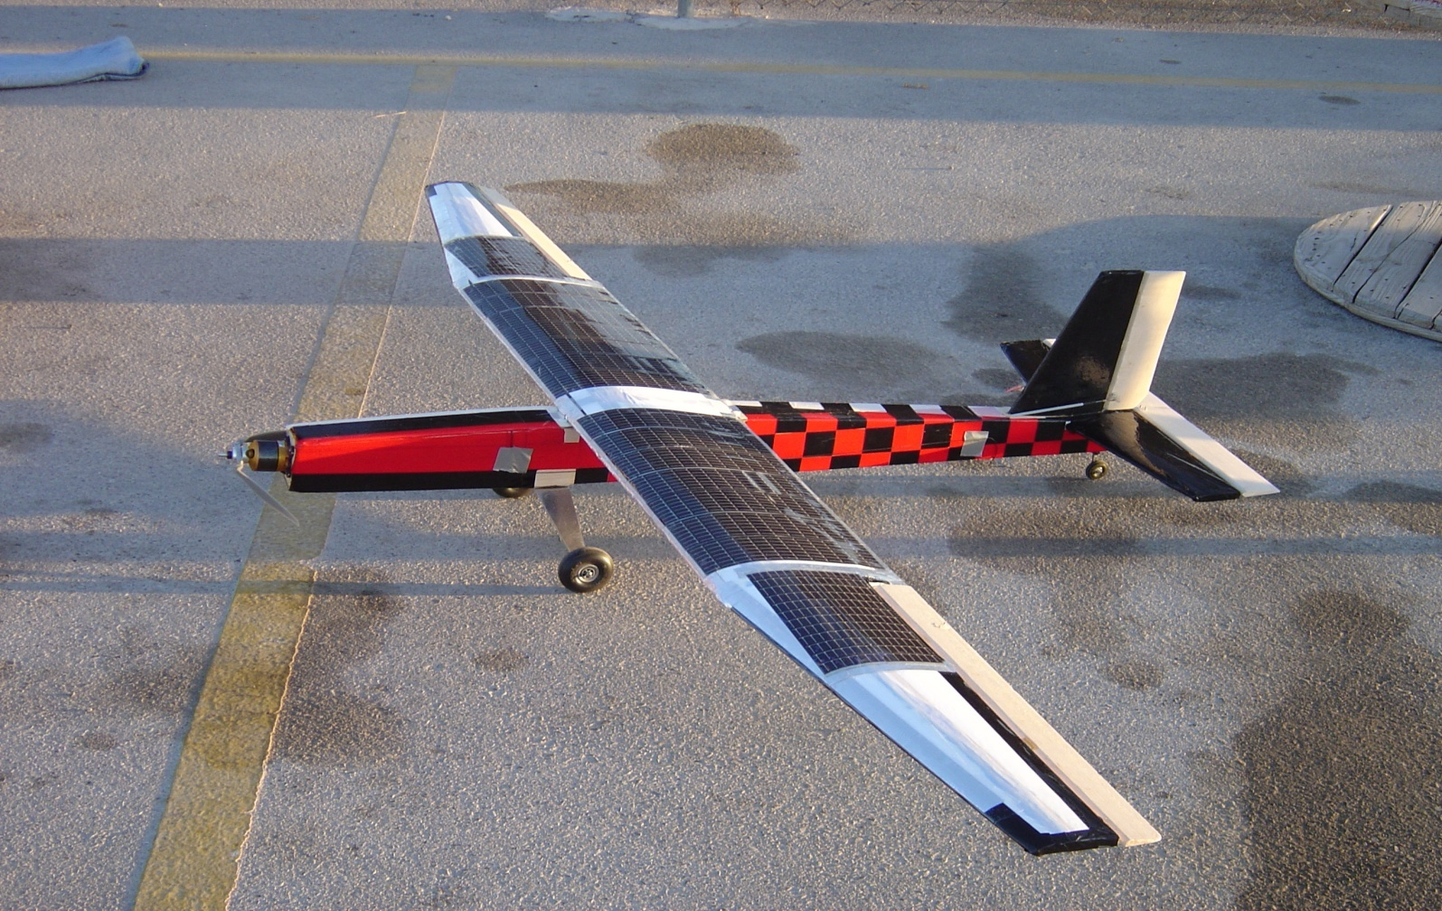
Starting Point
Final design of senior design project
Project Recommendations:
Fuselage and Wing Construction
Drag Reduction
Control Surfaces
Solar Array and Charging System

Slide 4
Thin-Film Solar Cells
In many cases, uses less than 1% of the raw material as compared to wafer-based solar cells, resulting in significant price drop per watt
So far, less efficient than wafer solar cells
Printability
Easily conforms to wing or fuselage surfaces
Requires minimum maintenance

Slide 5
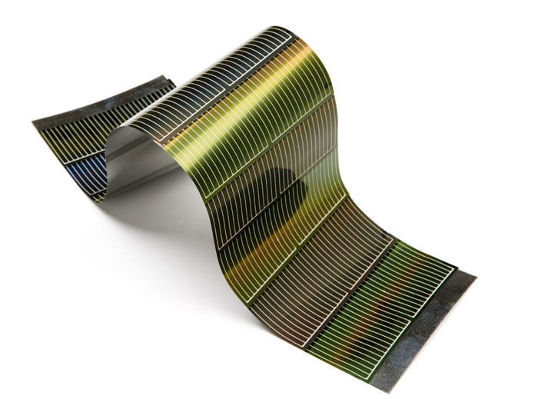
Thin-Film Solar Cells (cigs)

Slide 6
Thin-Film Solar Cells
Amorphous silicon
The most common type of thin film cells, they are not printable.
CIS
This is a printable thin-film that attempts to drive down the cost by using copper, indium, and selenium instead of silicon.
CIGS
This is also printable and is very similar to CIS cells, the most important difference being gallium is used to replace as much of the expensive indium as possible.
CSG
Silicon offshoot that shows promise; gives up some flexibility for efficiency.

Slide 7
Mission Analysis

Slide 8
Refined Mission Requirements
Refined mission requirements point to a maximum ceiling of 10,000ft AGL for energy height.
Ability to run racetrack pattern over target for surveillance is paramount.
25° bank angle, sustained turn was chosen as appropriate for this application.
The airframe must also sustain turning attitude to ride thermals.

Slide 9
Typical Mission Profile
Loiter
Cruise
Glide
Glide
Climb/Thermal
Climb/Thermal
Climb
Takeoff
Land

Slide 10
Final Design

Slide 11
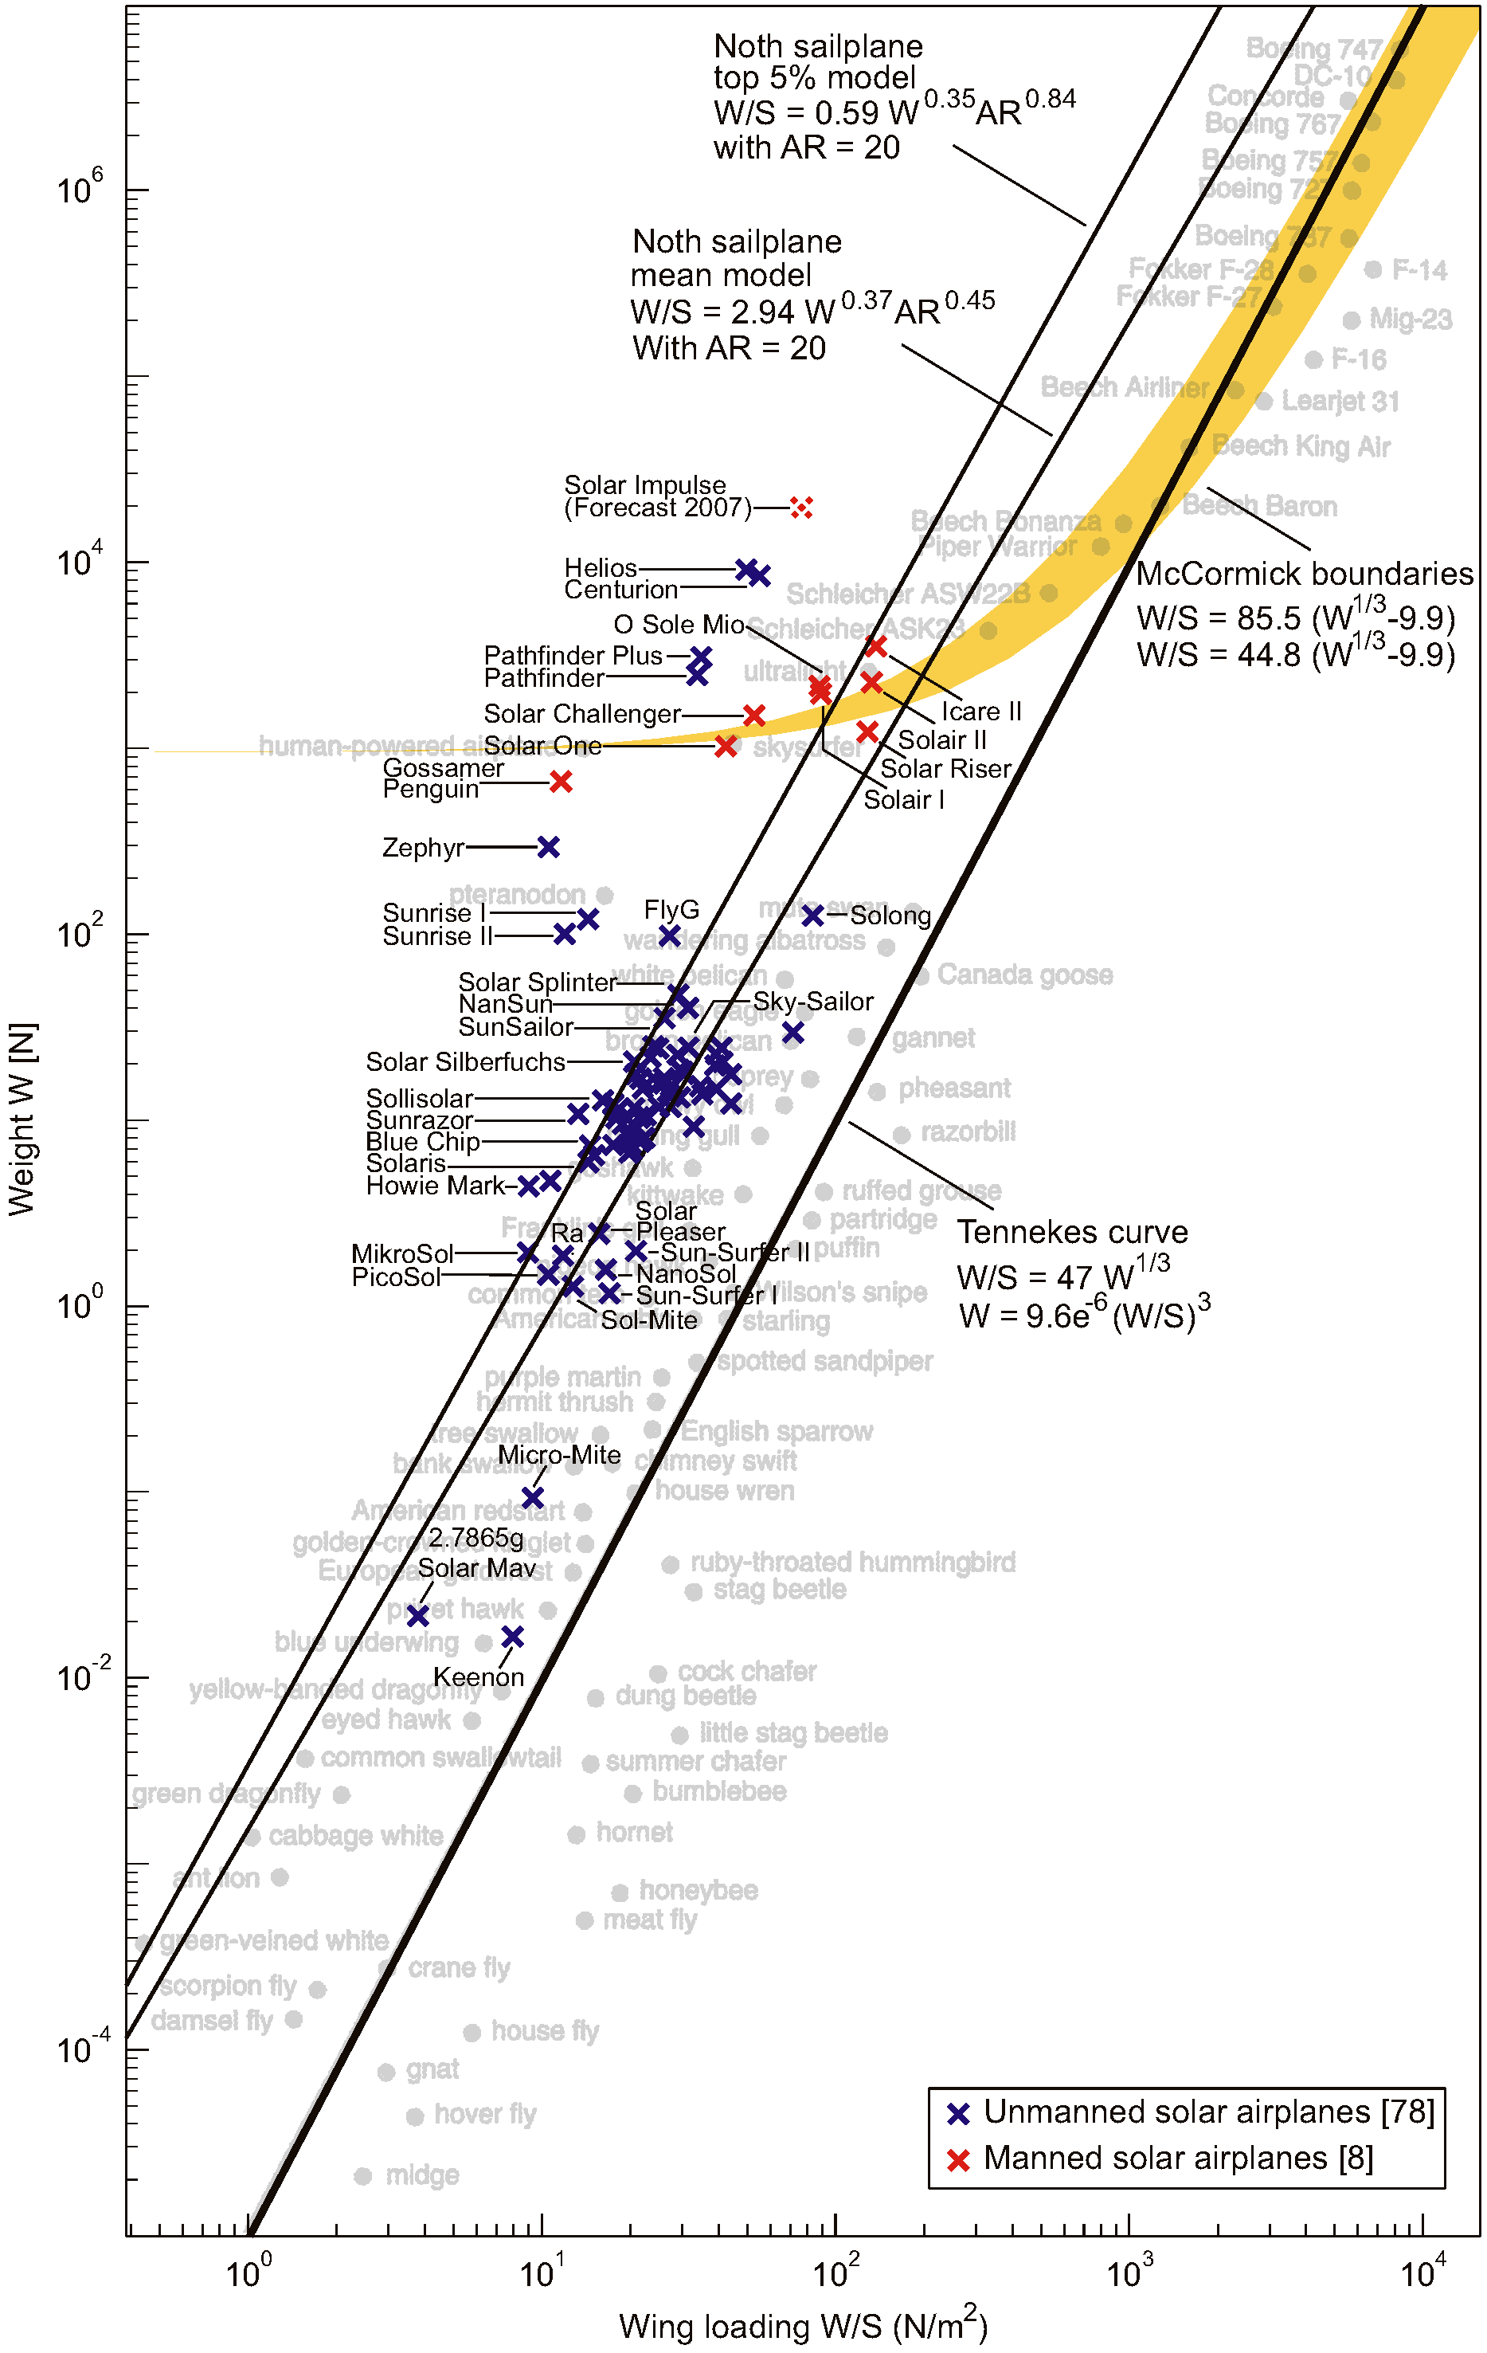
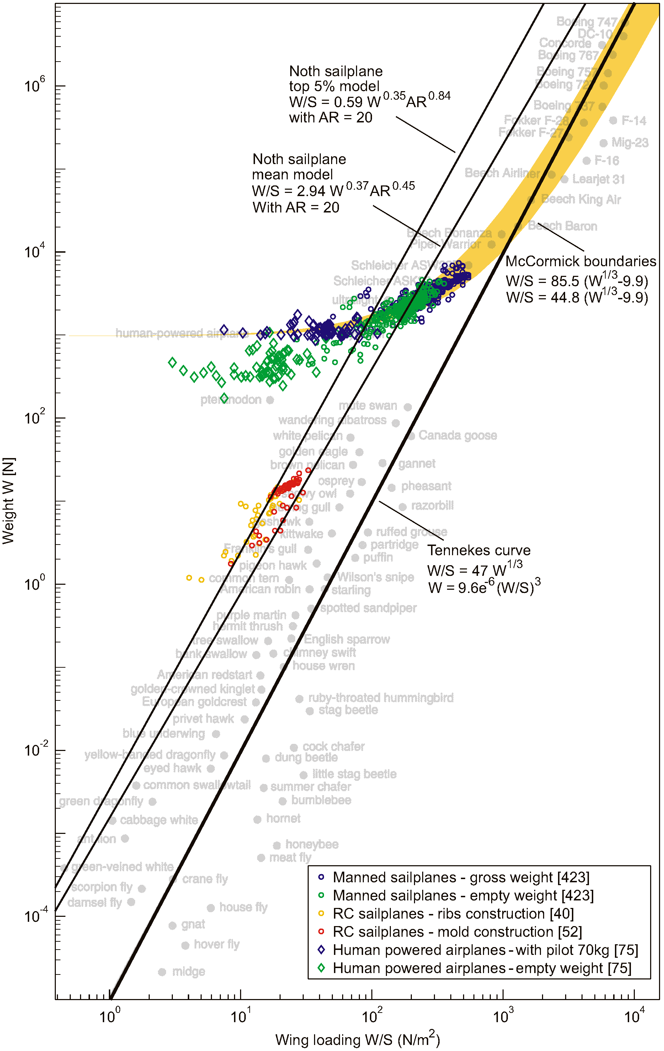

Slide 12
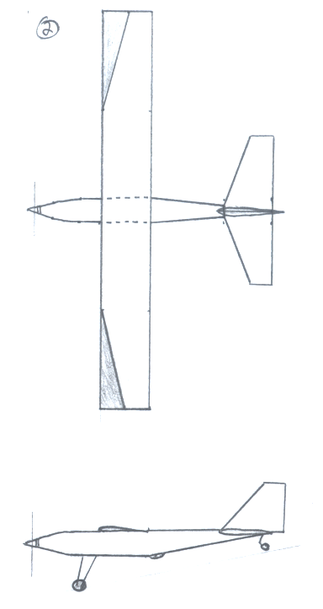
Sailplane Design

Slide 13
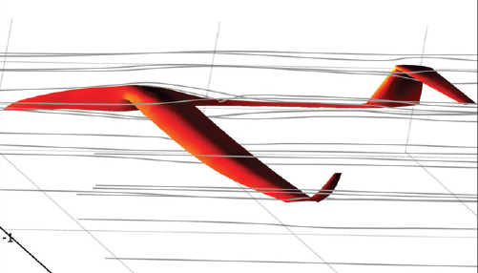
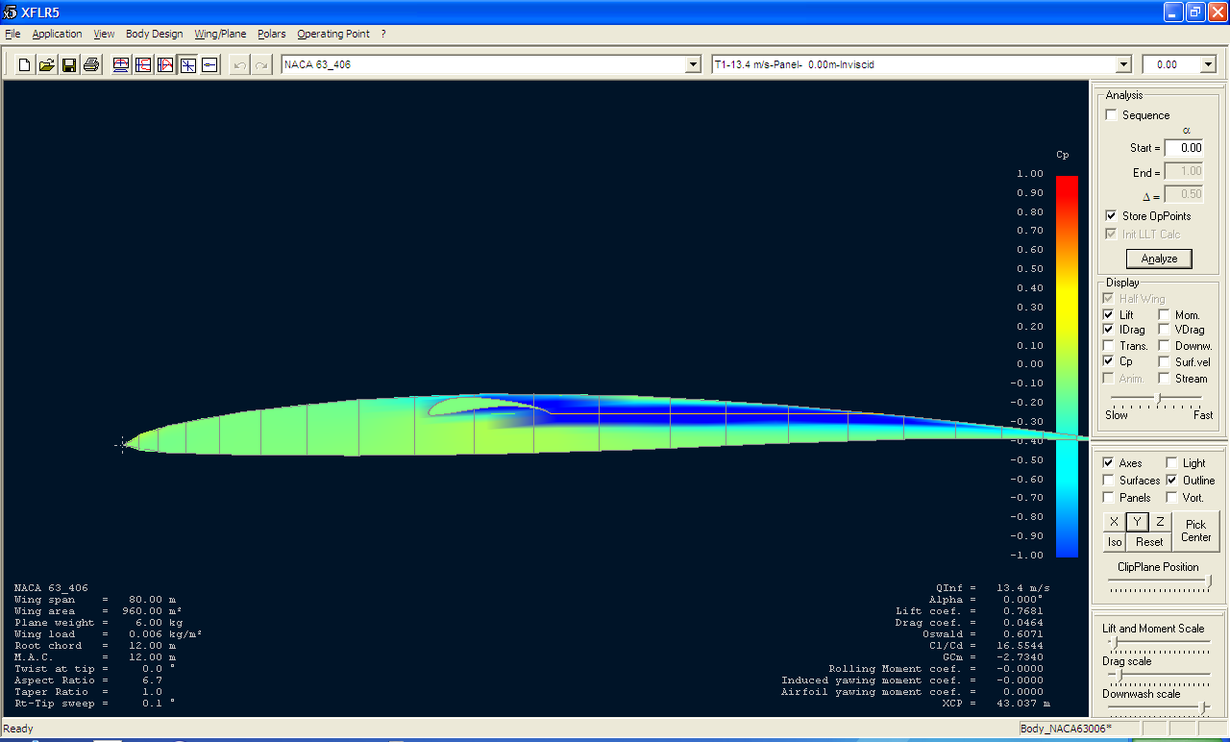
Fuselage Design
Airfoil Design
NACA 63-806
Preserve laminar flow
Accelerate flow into wing
Produce lift
Design Method
Airfoil
Taper after wing

Slide 14
Specifications
Wing Span | 108”
Length | 70”
Ground Height | 18”
Wing Area | 1404 in²
Aspect Ratio | 8.3
Solar Panel Area | 1250 in²
Panel Power Production | 78 W
Weight | 15 lbs

Slide 15
Airframe Optimization
Wingtip drag reduction devices
Complex airfoil and wing analysis
Fuselage-wing flow interaction
Flight behavior in different flight configurations
Ideas and calculations can be quickly and accurately modeled in COMSOL or other CFD software

Slide 16
Wingtip Devices

Slide 17
Wingtip Devices
Seek to reduce drag by harnessing the strength of wingtip vortices and to either redirect them or redistribute the vortex strength (or both)
Planar or non-planar

Slide 18
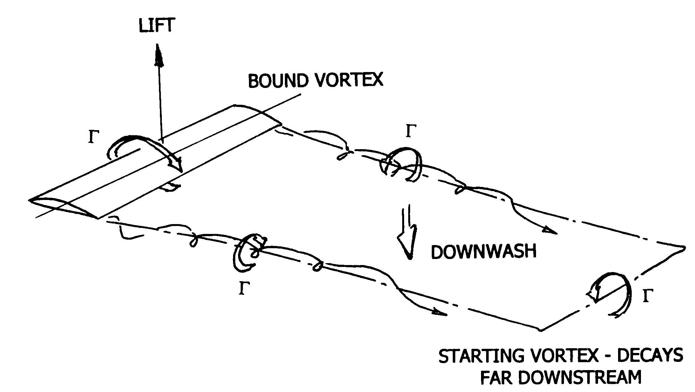
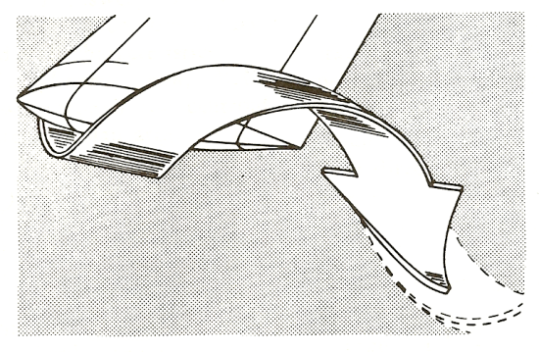

Slide 19
Planar Wingtip Devices
Lays in the plane of the wing
Two different general approaches:
Employs one or more sharp edges to hamper the reconciliation of pressure gradients
Employs a recirculation seat or zone to harness the momentum or strength of the vortices, or to deflect them outside of the wing’s plane

Slide 20
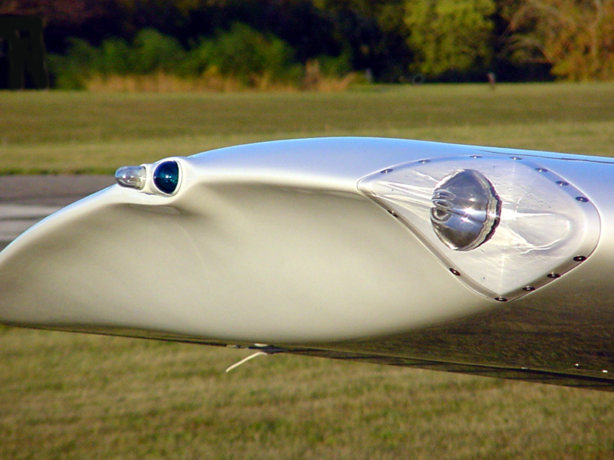
Planar Wingtip Device –hoerner tip

Slide 21
NON-Planar Wingtip Devices
Lays outside the plane of the wing
Considered a lifting surface that has a multitude of effects on the overall aerodynamic qualities of the wing:
Impedes the circulation about the wingtip by creating a side-force (the device’s lift force), increasing overall lift
Vertically diffuses the vortex flow further away from the wingtip, decreasing overall drag
May contribute to thrust (forward lift component)
Creates an increase in wing bending moment
Must remember: winglet has its own drag component

Slide 22
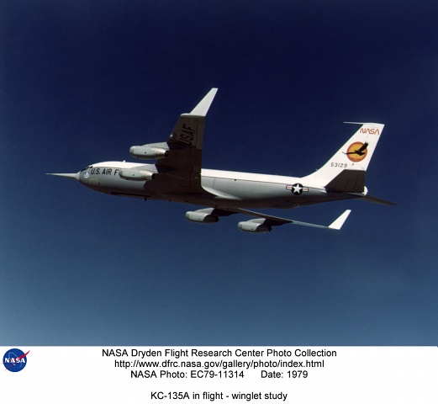
NON-Planar Wingtip Device
–WHITCOMB WINGLET

Slide 23
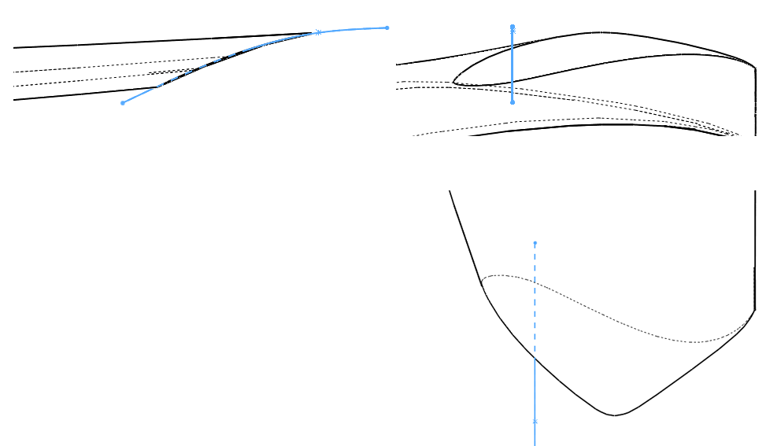
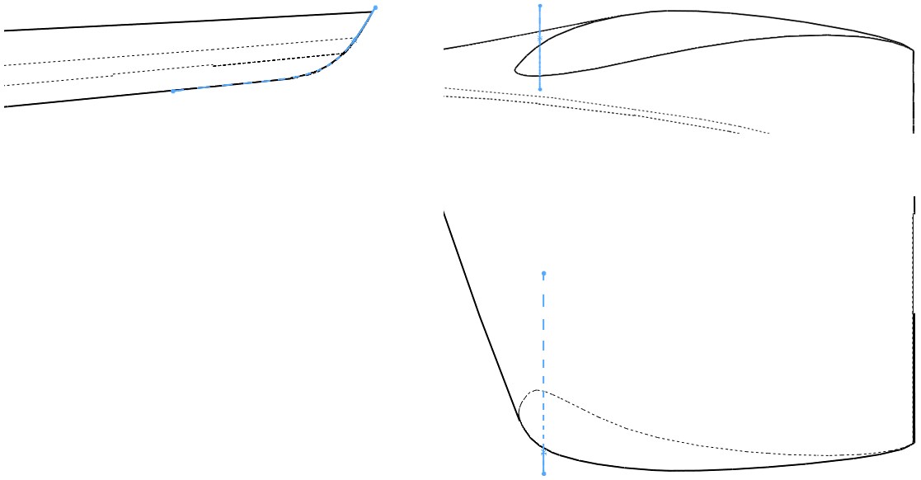
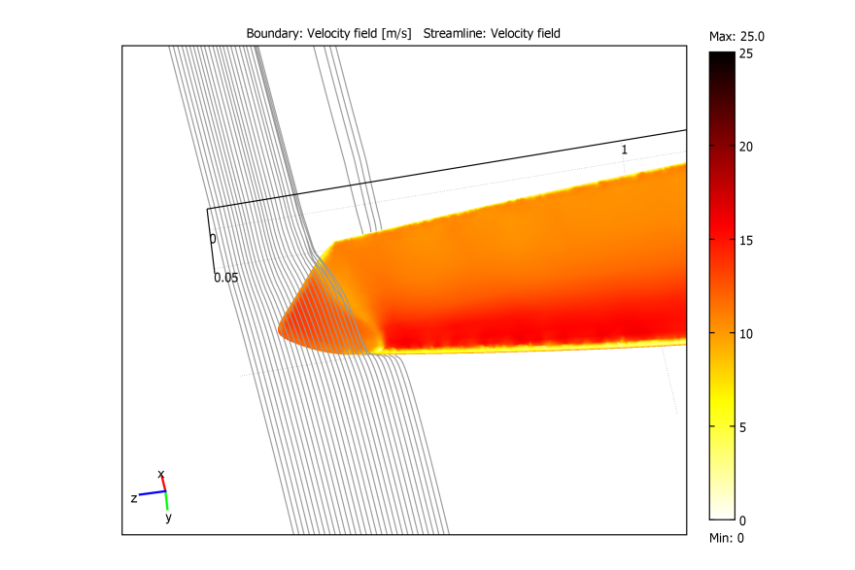
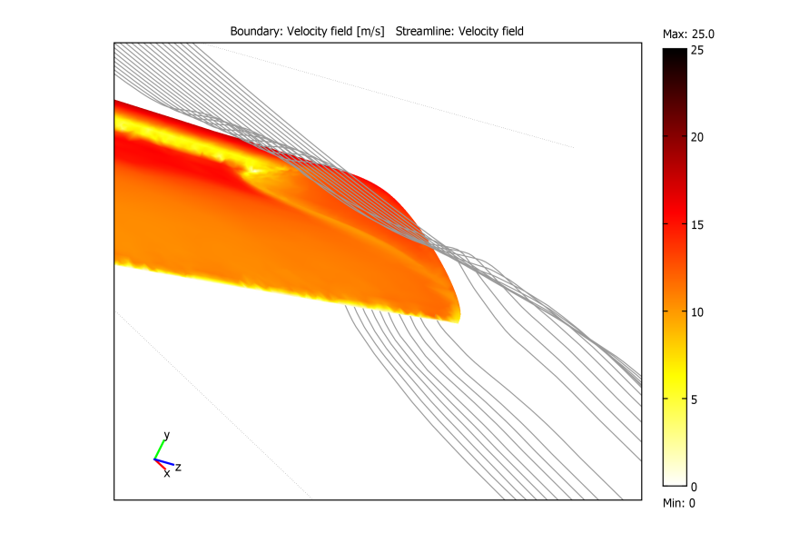
Planar Devices
Wingtip Device – Planar Device 01
Wingtip Device – Planar Device 02
PLANAR DEVICE 01 | Average Percent Change Over Control (loiter, level flight)
Drag Coefficient | 0.30%
Lift Coefficient | -1.49%
Lift-to-Drag Ratio | -1.78%
PLANAR DEVICE 02 | Average Percent Change Over Control (loiter, level flight)
Drag Coefficient | -2.89%
Lift Coefficient | 0.64%
Lift-to-Drag Ratio | 3.06%

Slide 24
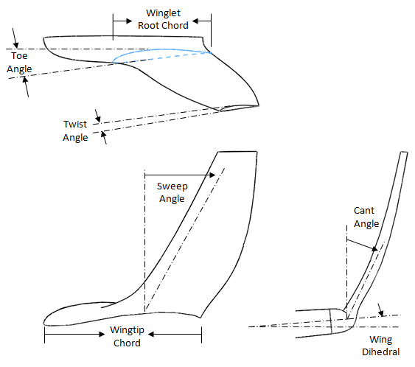
NON-Planar Device
DESIGN PARAMETERS

Slide 25
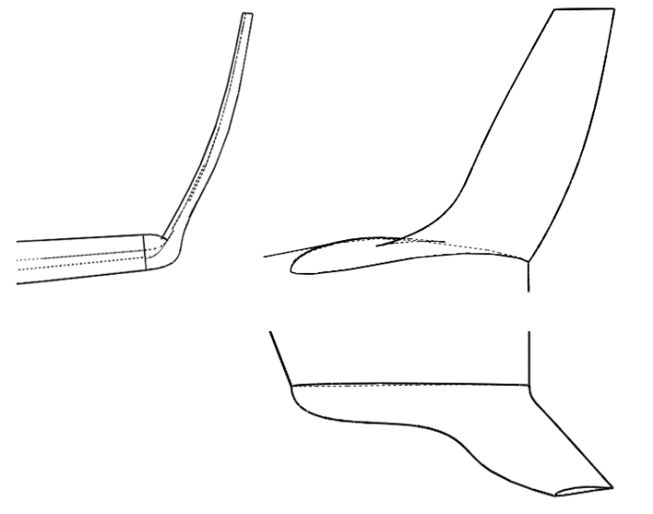
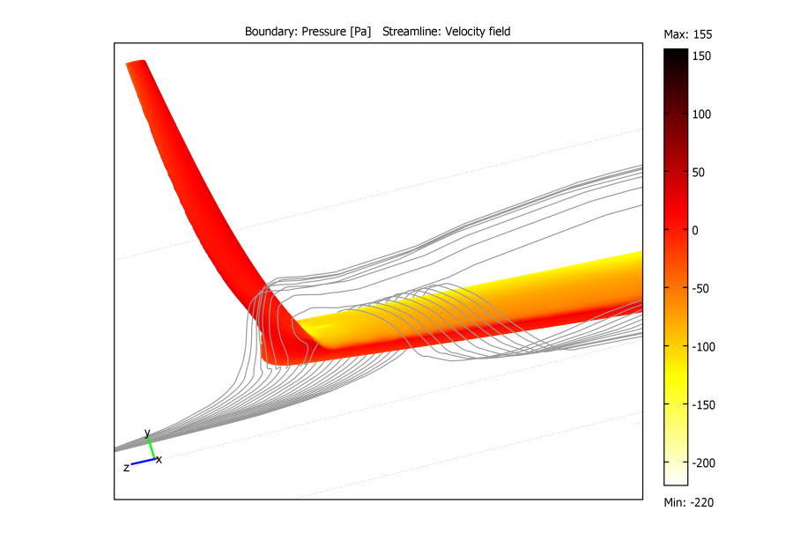
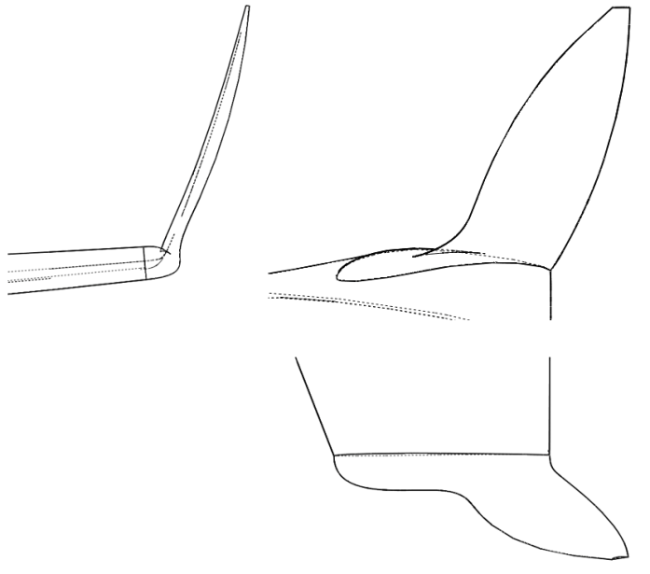
WINGTIP Device NON-PLANAR DEVICES
- Non-Planar Device 02
NON-PLANAR DEVICE 02 | (loiter, level flight) | (loiter, -2° AOA) | (loiter, +2° AOA) | (loiter, +4° AOA)
Drag Coefficient | -6.46% | -4.82% | -3.51% | -3.57%
Lift Coefficient | 2.89% | 0.35% | 2.13% | 2.39%
Lift-to-Drag Ratio | 10.00% | 5.43% | 5.85% | 6.20%
- Non-Planar Device 04
NON-PLANAR DEVICE 04 | (loiter, level flight) | (loiter, -2° AOA) | (loiter, +2° AOA) | (loiter, +4° AOA)
Drag Coefficient | -5.34% | 2.09% | 0.86% | -0.63%
Lift Coefficient | 2.43% | 1.57% | 1.78% | 2.50%
Lift-to-Drag Ratio | 8.21% | 0.50% | 0.92% | 3.16%

Slide 26
WINGTIP Devices -SUMMARY

Slide 27
WINGTIP Devices -SUMMARY

Slide 28
WINGTIP Devices -SUMMARY

Slide 29
RECOMMENDATIONS
Non-Planar Device 02 showed significant improvements over entire flight envelope
Devices in general were very sensitive to changes in geometry. Most attributable to laminar separation bubble and local Reynolds number:
Investigation of various NPD’s with a specifically designed airfoil may provide even better results

Slide 30
Wing-Fuselage Junctions

Slide 31
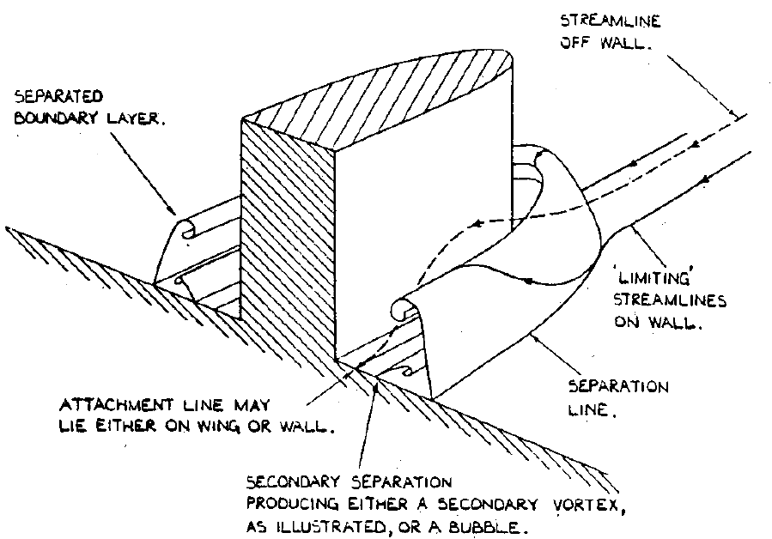
Wing-Fuselage Junctions
The way the wing connects to the body of the plane
Visibly identifiable as a combination of fairing and placement on the fuselage
Junction design usually aims for a particular goal:
Reduce drag
Increase lift
Eliminate flow separation
Increase stability and control characteristics

Slide 32
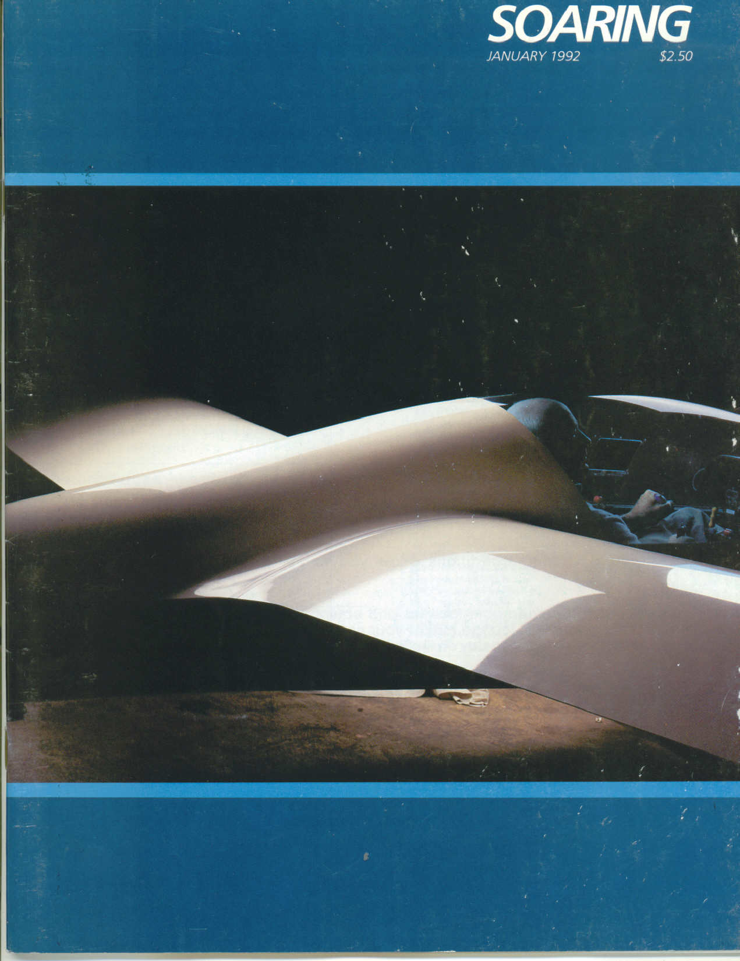
Wing-Fuselage Junction -SAILPLANE

Slide 33
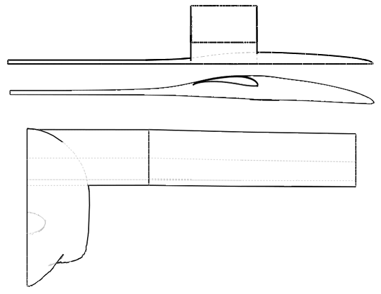
Wing-Fuselage Junction
CONTROL SPECIMEN
z
x
y
z
y
x

Slide 34
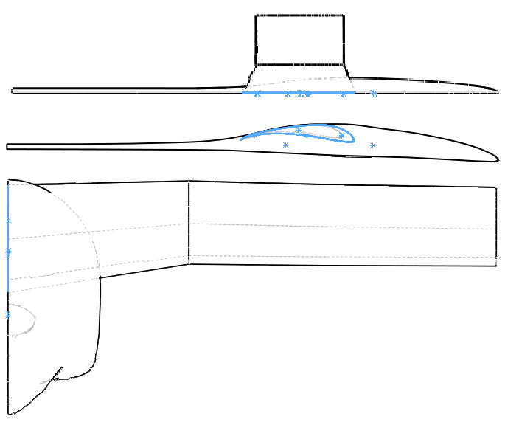
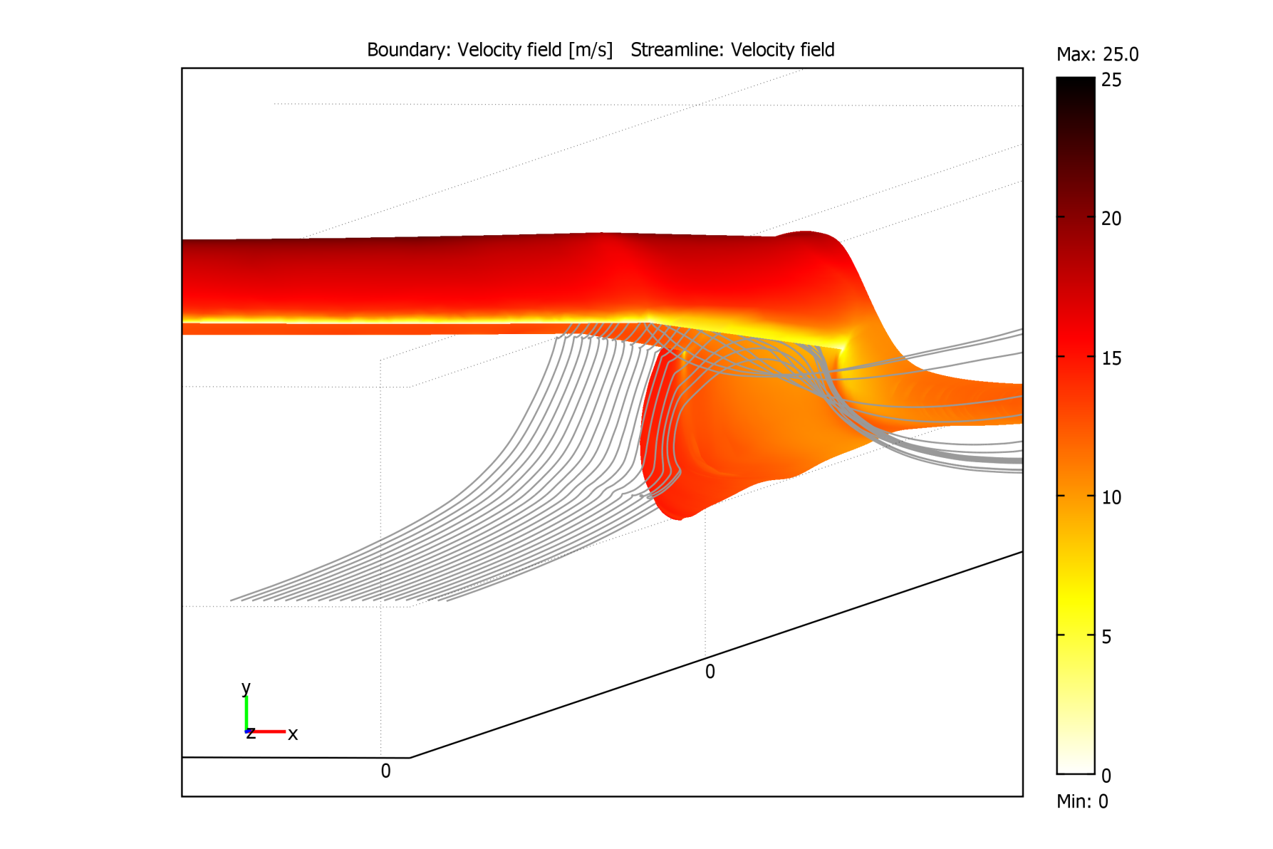
LINEAR Wing-Fuselage Junction 01
z
x
y
z
y
x

Slide 35
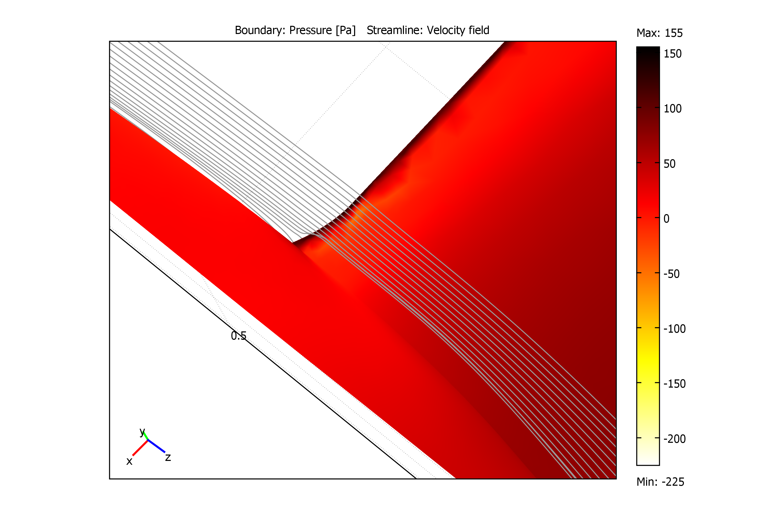
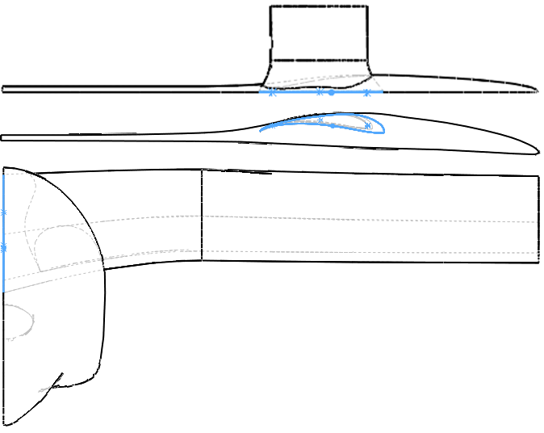
NON-LINEAR Wing-Fuselage Junction 01
z
x
y
z
y
x

Slide 36
WING-FUSELAGE JUNCTIONS -SUMMARY

Slide 37
WING-FUSELAGE JUNCTIONS -SUMMARY

Slide 38
RECOMMENDATIONS
Non-Linear Wing-Fuselage Junction 01 showed best improvement in performance although gains were minute
Results go against some of the literature but differences are easily explainable
Further design iterations with more complicated fairing shapes should be initiated

Slide 39
Component Selection

Slide 40
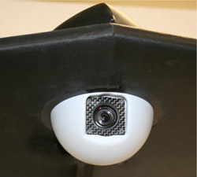
MicroUAV BTC-88
Ball Turret System
3.6” x 3.5” x 4.85”
275 grams
GPS autopilot referencing
Standard servo pulse code operation
FCB-1X11A Camera
10x optical zoom
Power consumption 6-12 VDC, 2.1 W max

Slide 41
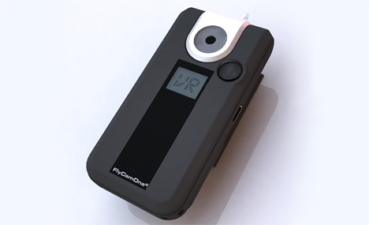
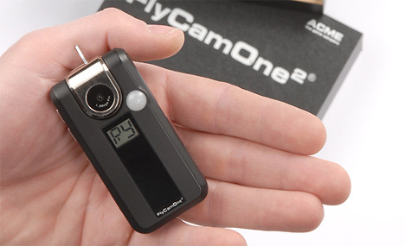
FlyCamOne2
Camera Stats
3” x 1.5” x 0.5”
640x480 Video
1280x1024 Photos
Remote Activation
2 Axis Control (Pan and Tilt)
2.5 Hour Record Time
Thermal activated motion detector
Inexpensive alternative

Slide 42
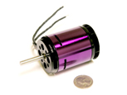
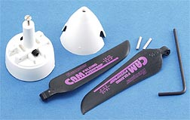
Propulsion System
Hacker A40 14L
Brushless Motor
310 KV rating
2.75 lbs Estimated Operating Thrust
6 Amp/hrs
18 x 10 Prop
Castle Creations
Phoenix 80
Electric Speed Controller

Slide 43
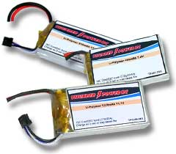
Lithium Polymer Battery Array
Nominal voltage per cell: 3.7 V
3S4P Configuration
11.1V
8000mAh
Possible operation at 22.2V
Lower percentage losses
Higher motor speeds
Power density 187 W/Kg

Slide 44
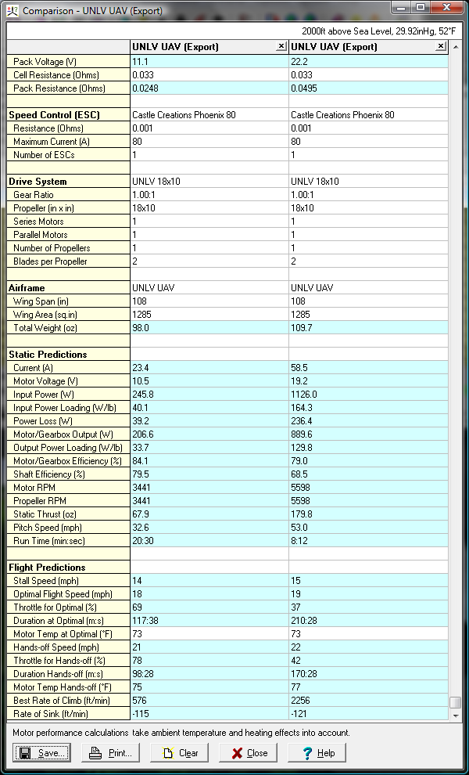
Battery Arrangement
Key Results from MotoCalc
Pack Voltage (V) | 11.1 | 22.2
Number of Pack | 4 | 2
Static Predictions
Motor Efficiency (%) | 84.1 | 79
Flight Predictions
Throttle for Optimal (%) | 69 | 37
Duration (min) | 468 | 420
(hours) | 7.8 | 7.0
Best Rate of Climb (ft/min) | 576 | 2256

Slide 45
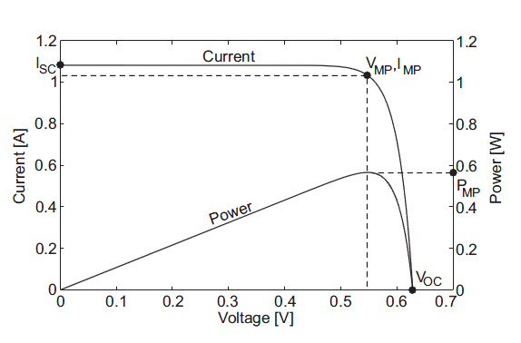
Maximum Power Point Tracker
Stats
Panel Voltage 0-27V
Efficiency 94%-98%
Tracking Efficiency 99%
80 grams
Benefits
Performance increase of 10-30%
Safely charge LiPo Batteries (require constant voltage)

Slide 46
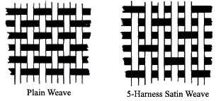
Composite Material
Material
Carbon Fiber
Sizing
1K
Weight
3.74 oz/sq yrd
Weave
5 Harness-Satin
Added flexibility over complex features

Slide 47
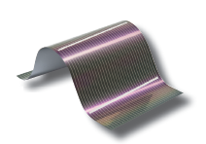
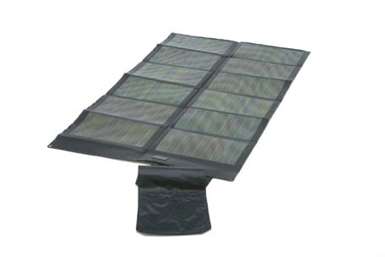
Solar Array
G2- Thin Film Solar Cells
P3 Portable Power Pack
Average Efficiency %10.2
72” x 8.25”
Vmpp: 7.3V
Impp: 5.4A
Power: 39.5W
Average Efficiency ~%7.3
52”x 30”
Vmpp 20V
Power 62W
Encapsulated

Slide 48
Construction

Slide 49
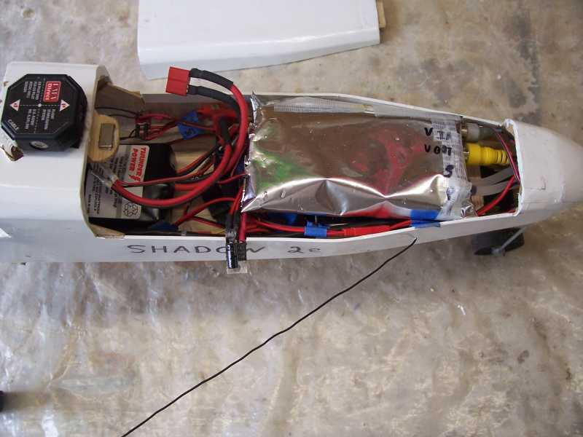
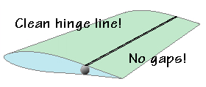
Construction Milestones
Airframe construction
Carbon fiber foam body
Avionics programming and testing
Avionics integration
Control surfaces
Solar array install
Wing-fuselage joining
Flight testing

Slide 50
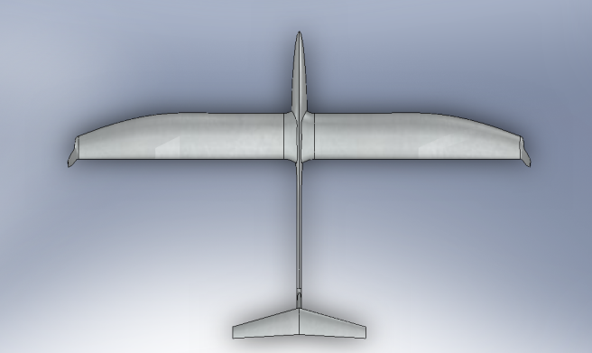
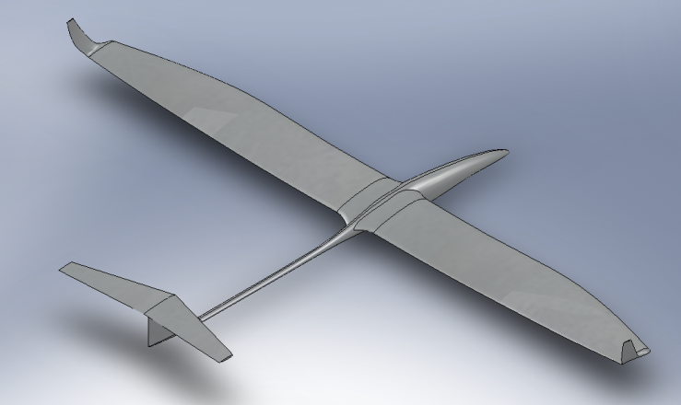
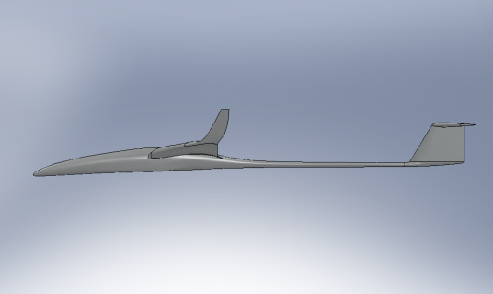
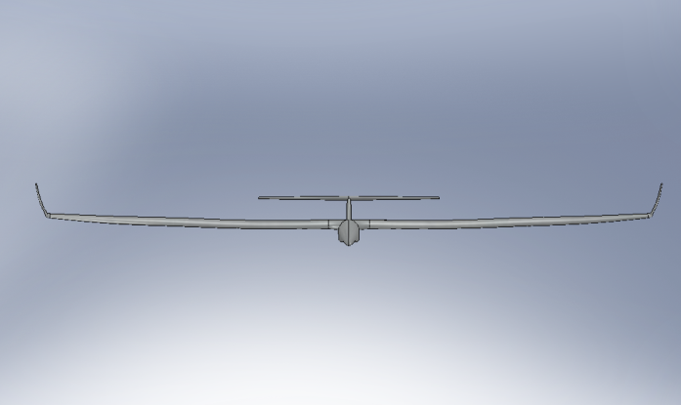
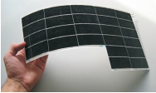
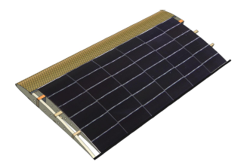
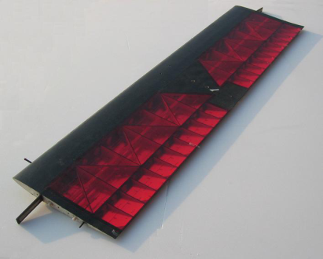
CONCLUSION
Max Payload: 12-15lb
Final Cost: $5400
Loiter Time:
Continuous Run Time: 7 hours
Hand Launch
Solar Array
CIGS Thin Film 62W Array
Investigate Silicon Cells
Construction technique
Components advances
Flight Testing

Slide 51
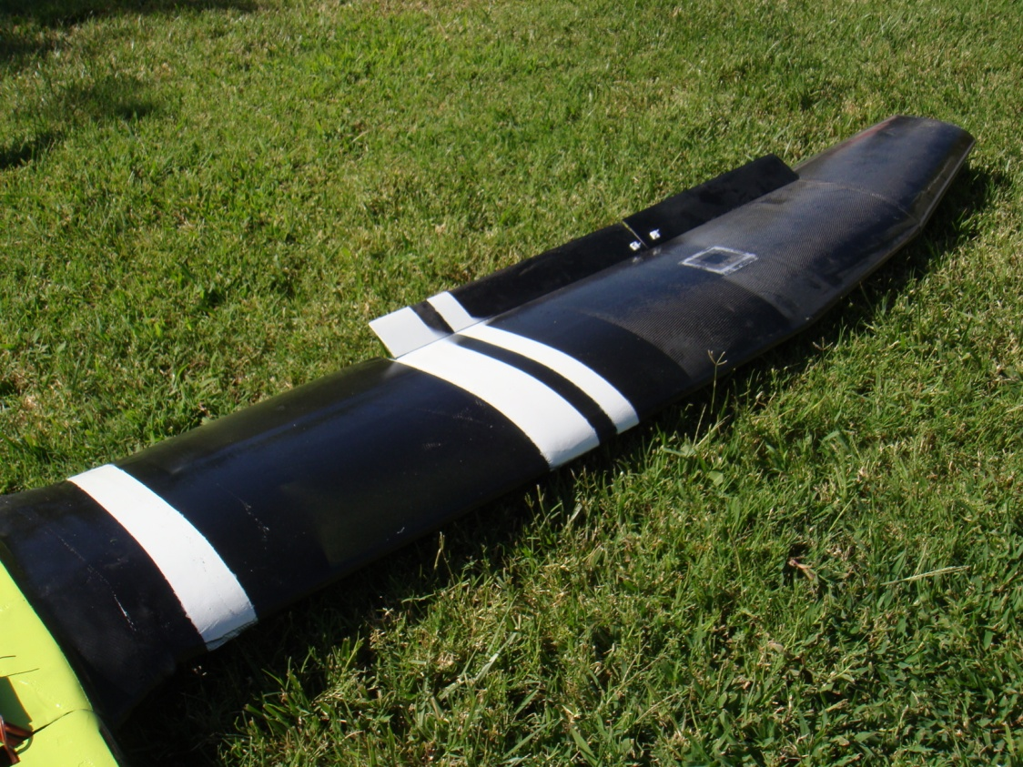
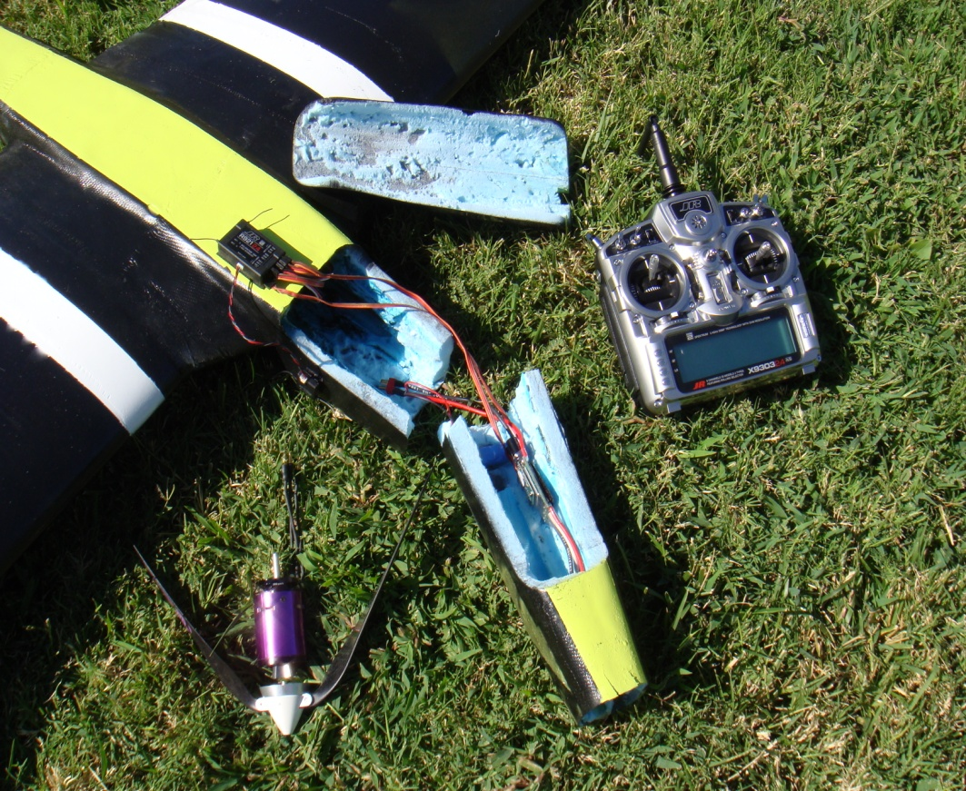
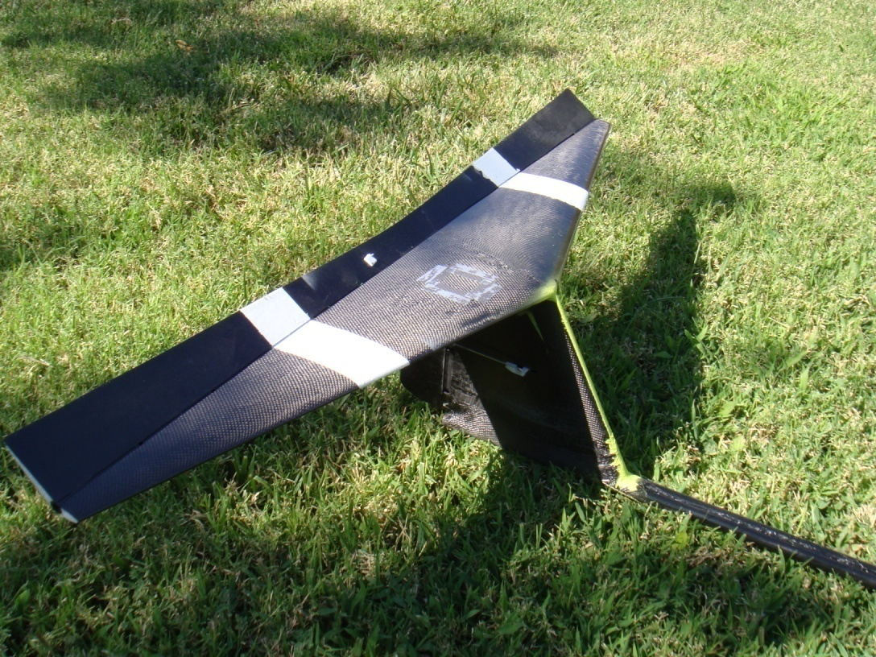
HOWIE MARK IV

Slide 52
QUESTIONS?

