Slide 1
Delivering space education: From Earth to orbit and beyond… The University of North Dakota Space Studies M.S. program
Dr. Paul S. Hardersen
Director, ND Space Grant Consortium
Fall ’08 meeting of National Council of SG Directors
Tuesday, October 28, 2008, 9:40 a.m.

Slide 2
A vision
Formed in 1987 at the University of North Dakota (UND) by Buzz Aldrin and David Webb.
Goal: Develop and implement a graduate-level, inter-disciplinary space education degree.
Originally developed as an on-campus program that also served U.S. Air Force bases in North Dakota.
One of the first space studies programs of its kind in the world.

Slide 3
Relevance to NASA and Space Grant
Emphasizes interdisciplinary learning – beyond simply science and engineering.
Fosters international cooperation – a key trait of many current and future space missions.
The leading space authority in North Dakota – a partner with North Dakota Space Grant.
Enables and fosters new and ongoing STEM NASA-relevant research.

Slide 4
The facilities

Slide 5
The early years
Disciplines: 1) space engineering, 2) space physical sciences, 3) space policy/history, 4) space law, 5) Earth remote sensing, 6) management and commercial space.
Faculty specializes in above disciplines to provide students with a broad understanding of the various segments of the space industry.
Another innovation: Distance M.S. program began in 1996.
Result: Enrollment launches with almost exponential growth.

Slide 6
The space.edu revolution
Allows international students to join program – gaining a vital perspective.
Online learning via:
Recorded lectures.
Interactive chats.
Multi-disc learning.
Students: Primarily mid-career professionals with aerospace job who desire to broaden their education.

Slide 7
Student characteristics
601 graduates through Summer 2008.
32 countries represented.
Employees of NASA, industry, U.S. military, Canadian military, schools and universities….and a few odd jobs…

Slide 8
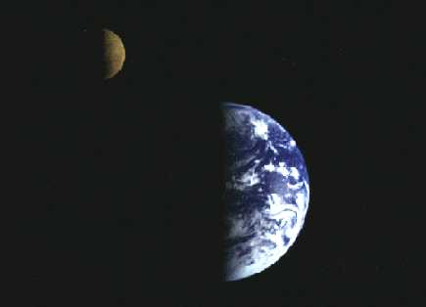
Space Studies Capstone
Large-scale mission design concept.
Summation of M.S. program for distance students.
Stresses technical realism, interdisciplinary interactions, in-depth investigations.
2008 concept: Astronaut rescue mission in the Earth-Moon system.
Guest expert: Dan Adamo

Slide 9
Comparing UND and ISU
UND
2-yr M.S. degree (33 cr.).
Summer course(s).
Interdisciplinary.
International.
Thesis option.
Non-thesis option.
Research opportunities.
Public support.
ISU
1-yr M.S. degree.
Summer program (SSP).
Interdisciplinary.
Exec. Space MBA.
International.
Non-thesis option.
Private support.

Slide 10
2001-2008: An evolution
Pre-2000: A teaching-only department.
2001-2008: Multiple changes and innovations:
Faculty tasked with teaching, research, and service.
M.S. thesis option begins – campus and distance students.
Major new research: NDX-1/NDX-2 planetary space suit.
Commitment to excellence: Renovation of UND Observatory.
Greater interaction with ND Space Grant Consortium.

Slide 11
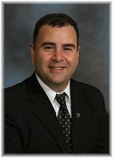
Research: Increasing student opportunities

Slide 12
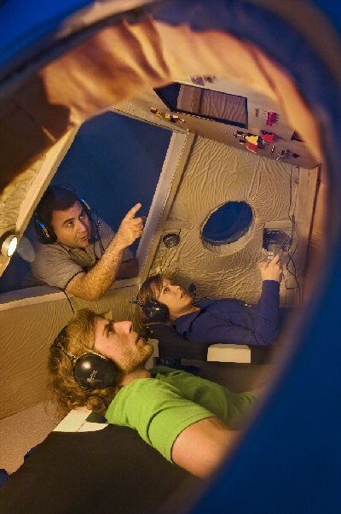
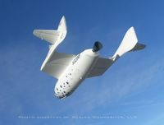
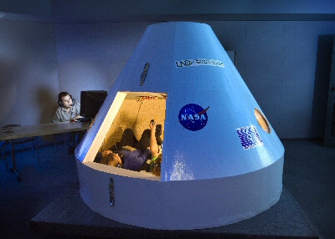
Spacecraft simulators

Slide 13
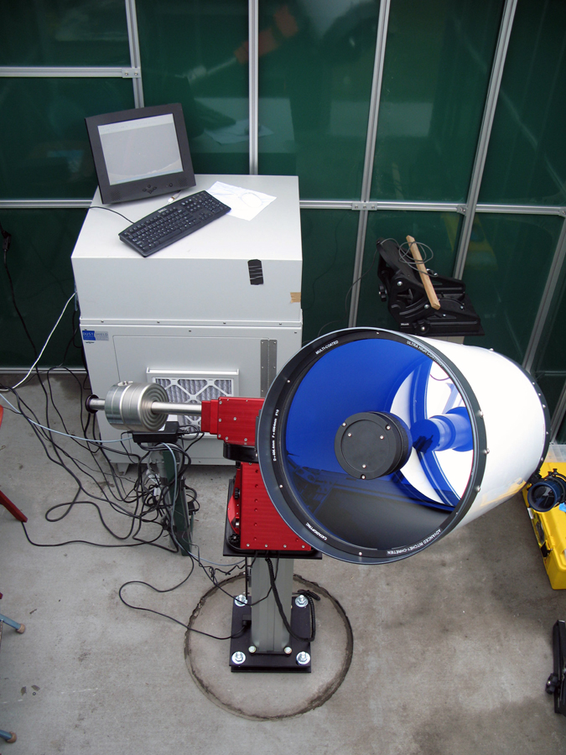
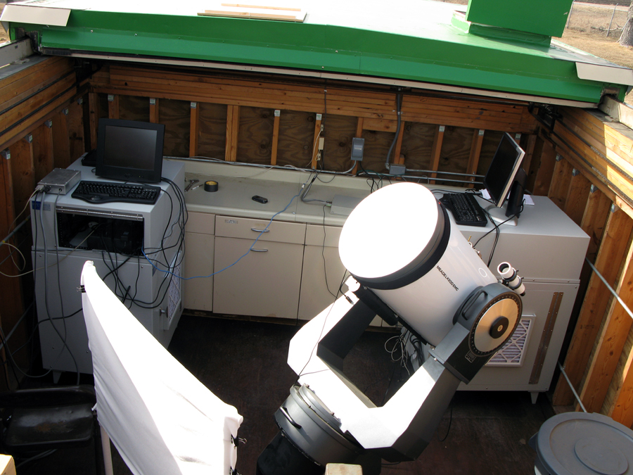
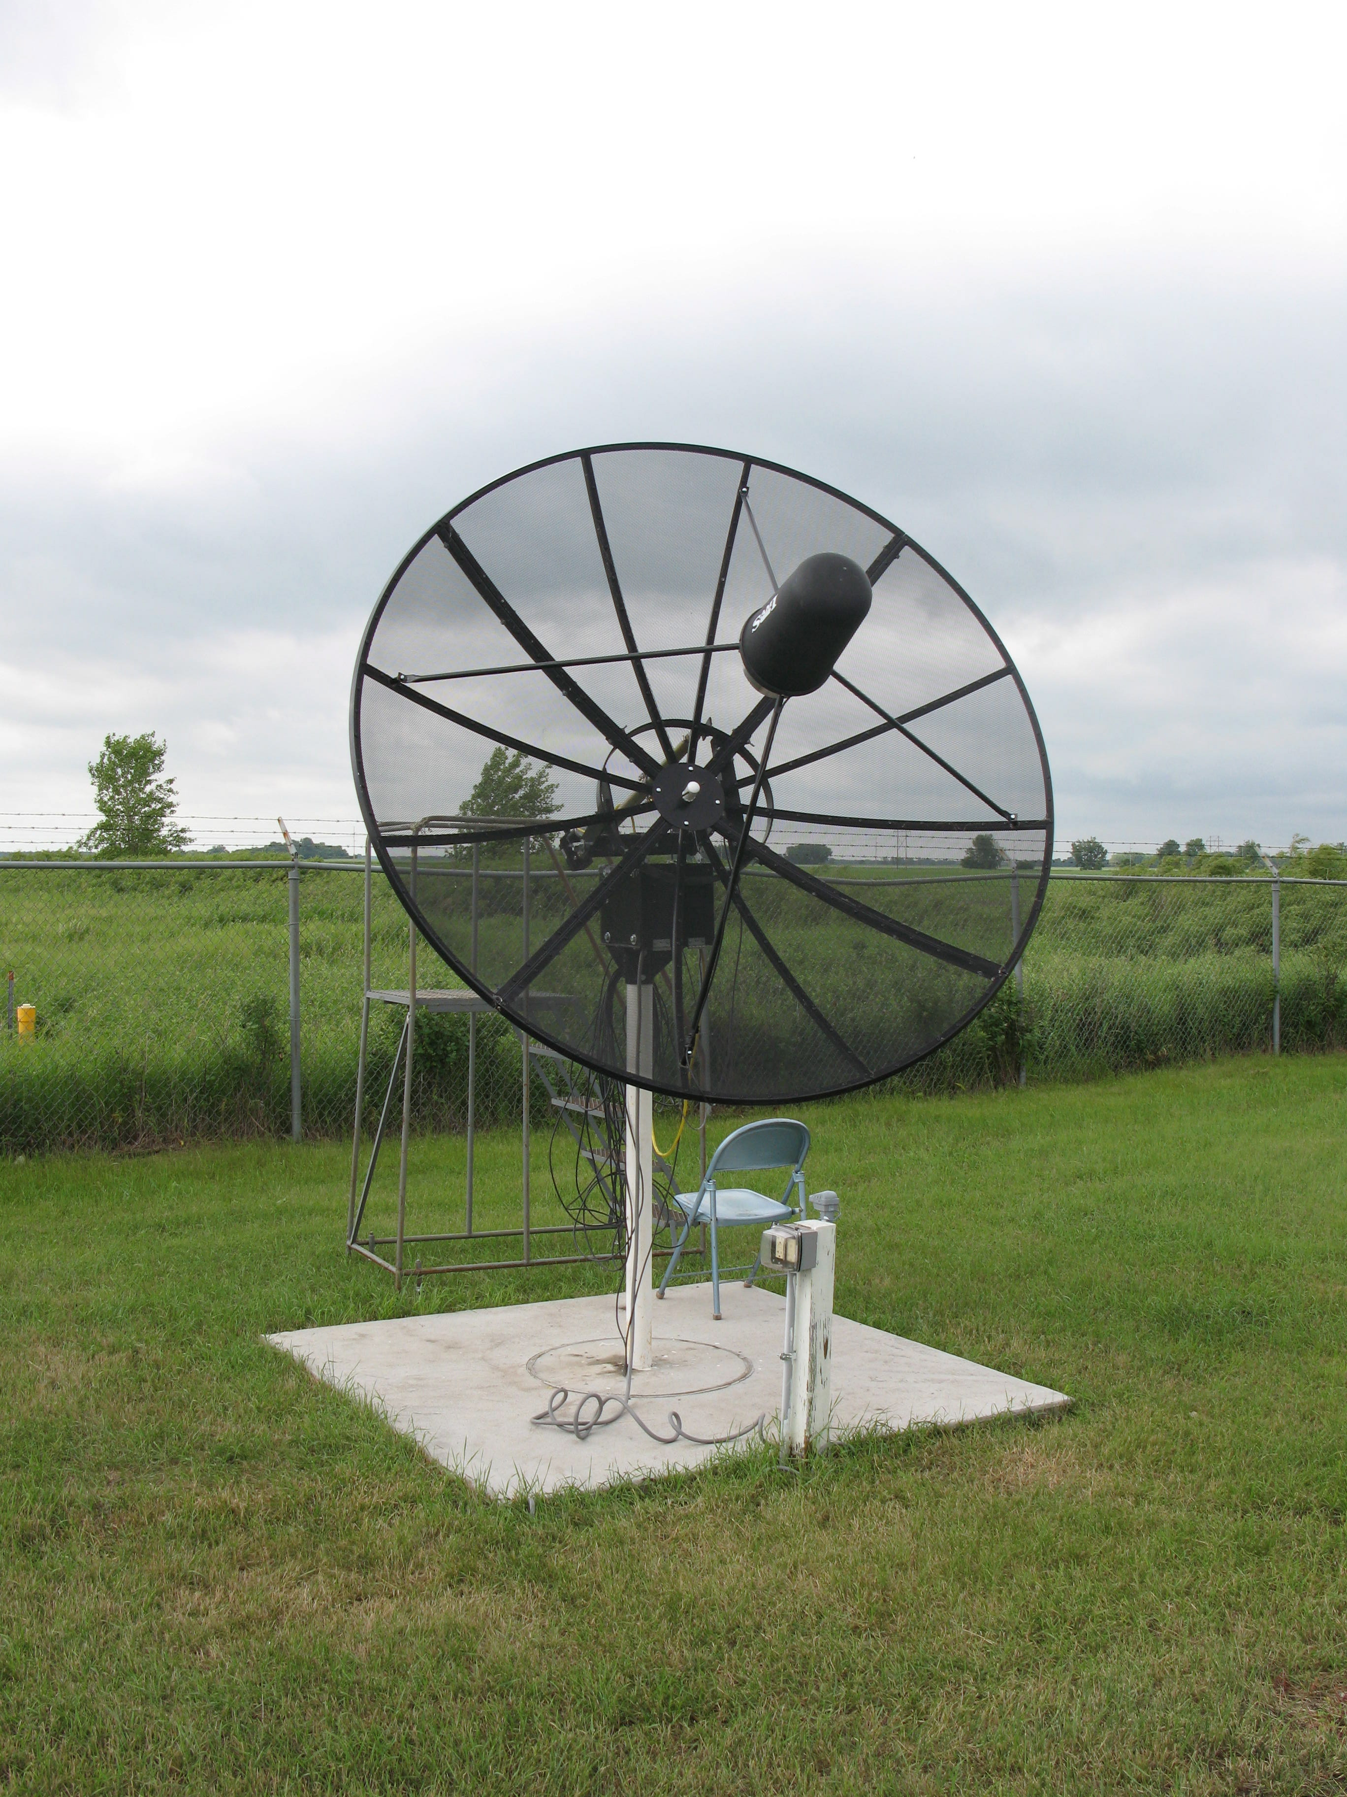
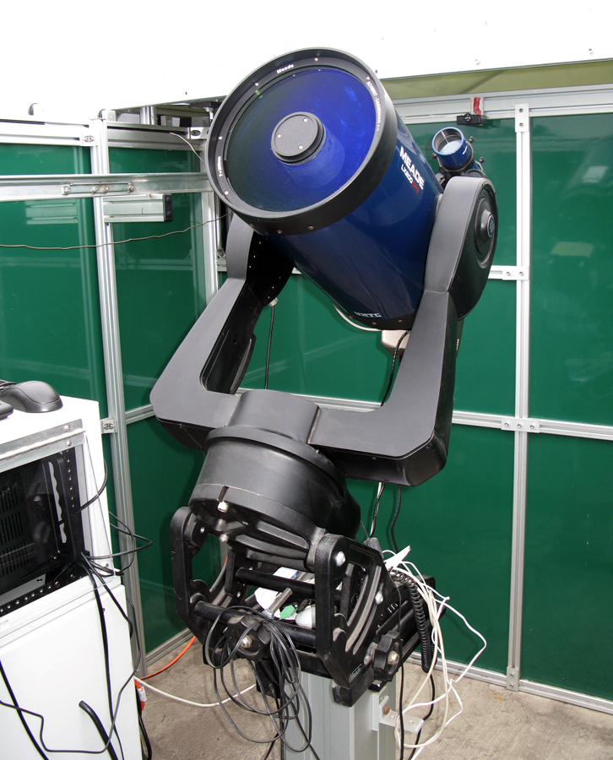
UND Observatory/SGITN

Slide 14
Research Focus Areas/Space Studies
Astronomical/planetary science research – NASA funded NEO/main-belt asteroid NIR spectroscopy. UND Observatory serving as a training ground for undergraduate and graduate students.
Planetary space suit – NDX-2 lunar suit program in progress.
Earth sciences – Remote sensing of land use in developing countries.
Material sciences – Polymers/coatings and material development.

Slide 15
Bending metal…
Nate Ambler participated in HASP – assisted development and testing of solid-state O₃ sensor.
Participated in ‘08 RockOn workshop – plans to continue in ‘09.
Participating in the UND AgCam for the ISS.
UND Observatory begins regular operations in ’09 -- ~$150,000 investment since 2005.
Plans to develop an in-house satellite manufacturing capability (CubeSat, NanoSat, etc.).

Slide 16
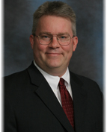
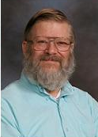
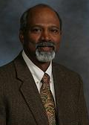
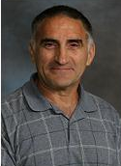
The faculty

Slide 17
Future goals and aspirations
Seek approval of a Space Studies Ph.D. program – will include depth and breadth requirement.
Collaboration with International Space University – possibly with Ph.D. program.
Beginning aggressive recruiting campaign to promote the program.
Seeking to establish direct ties with NASA and industry to increase student opportunities and involve department directly into NASA missions.

Slide 18
Contact information
Flyers available at this conference!!!!!
UND Space Studies program: http://www.space.edu.
Human spaceflight Summer ‘09 course: deleon@space.edu.
SGITN/UND Observatory: Hardersen@space.edu.
Satellite/spacecraft projects: rfevig@space.edu.

